Slide 1



Rows
Gaps
columns
1
2
3
4
5
6
7
8
9
header
Nav_lInk
rows
1
nav
2
header
logo
copy
2
logo
copy
g2
g1
H1 right
1
Nav_lInk
Hover areas
article
3
g2
main
article
g1
H1 left
img1
3
main
img1
4
4
g1
img2
img3
g2
5
5
img2
img3
img4
img5
img4
img5
g2
g2
footer
Icons
6
6
Fa fa insta
Fa fa
fb
Fa fa
lidin
Copyright
7
7
Copyright
footer

Slide 2







columns
1
2
3
4
5
6
7
8
9
header
Nav_lInk
rows
1
nav
2
header
logo
copy
2
logo
copy
g2
g1
H1 right
1
Nav_lInk
Hover areas
article
3
g2
main
article
g1
H1 left
img1
3
main
img1
4
4
g1
img2
img3
g2
5
5
img2
img3
img4
img5
img4
img5
g2
g2
footer
Icons
6
6
Fa fa insta
Fa fa
fb
Fa fa
lidin
Copyright
7
7
Copyright
footer

Slide 3
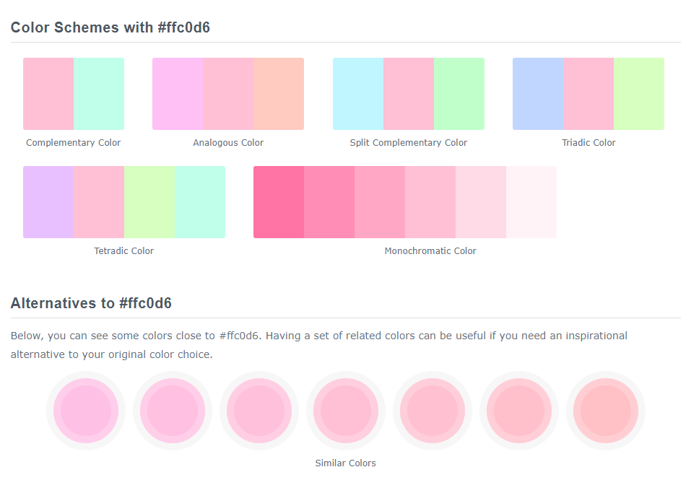
Colour Schemes with #ffc0d6
https://www.colorhexa.com/ffc0d6

Slide 4
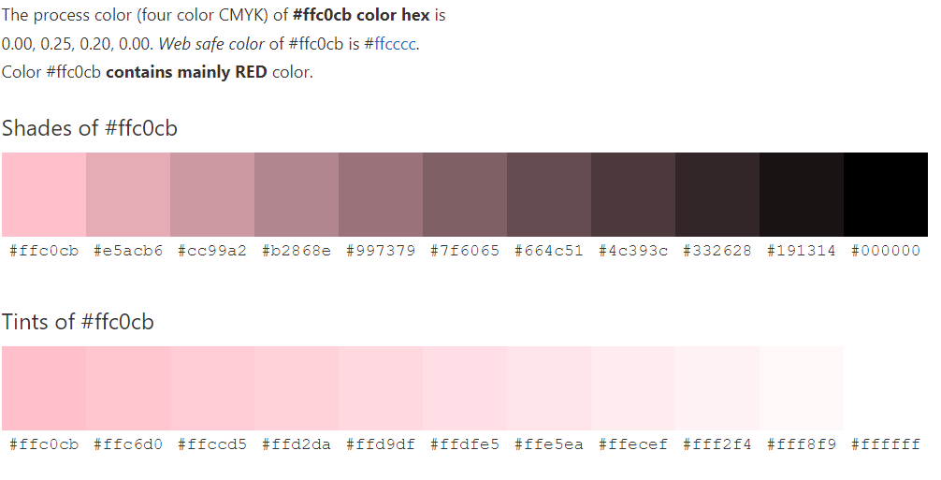
Colour tone Schemes
https://www.color-hex.com/color/ffc0cb

Slide 5
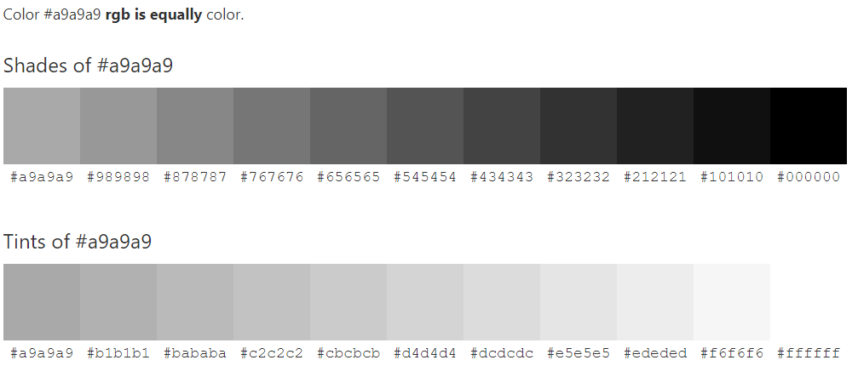
Greys
https://www.color-hex.com/color/a9a9a9

Slide 6
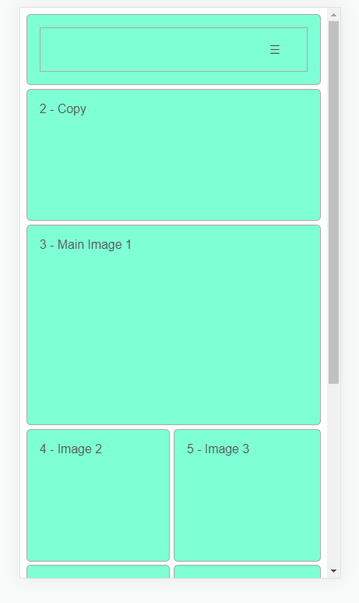
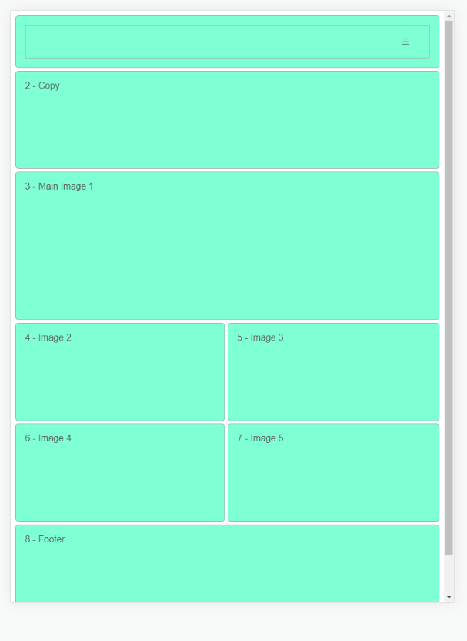
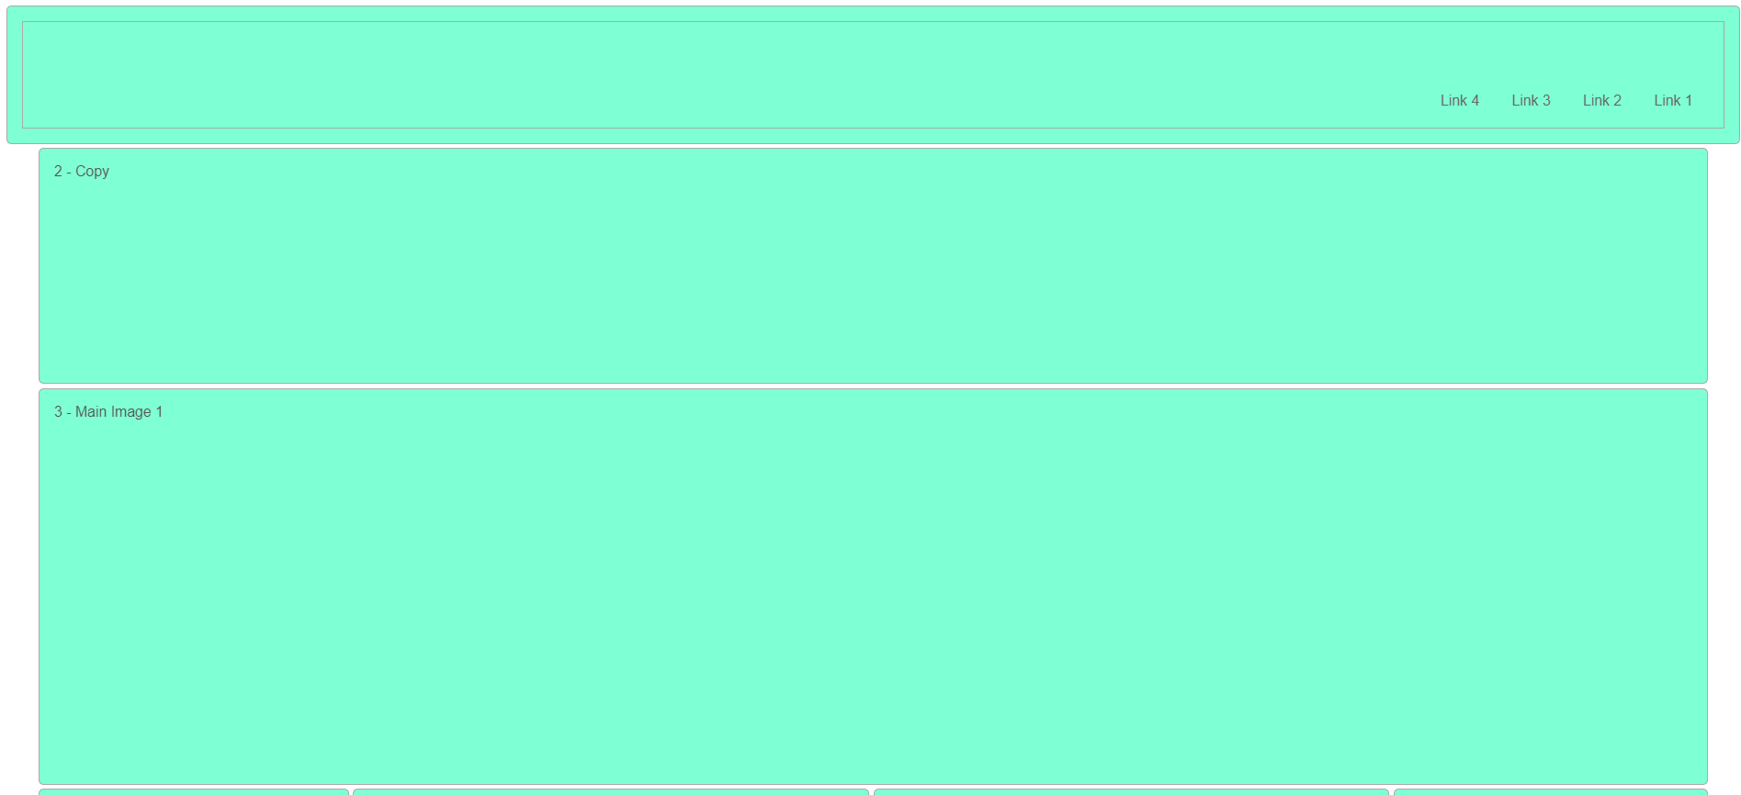
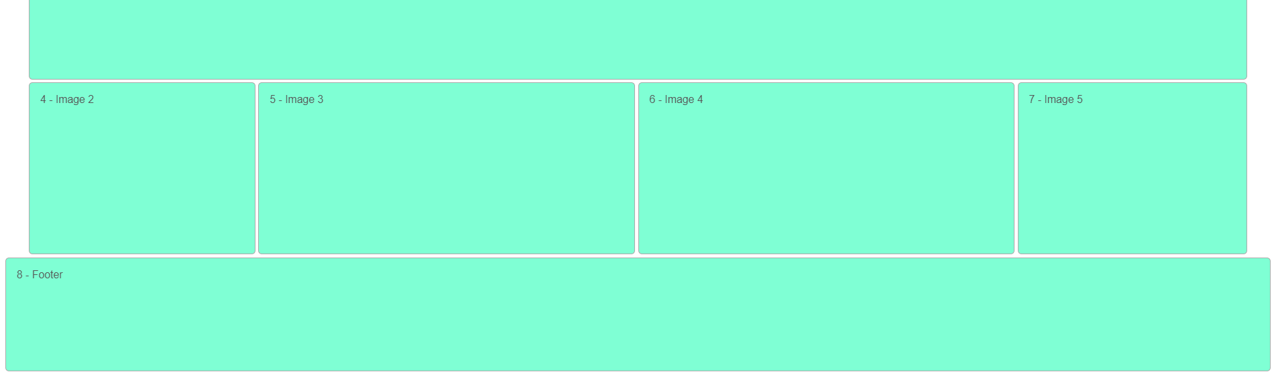
Responsive screen templates

Slide 7

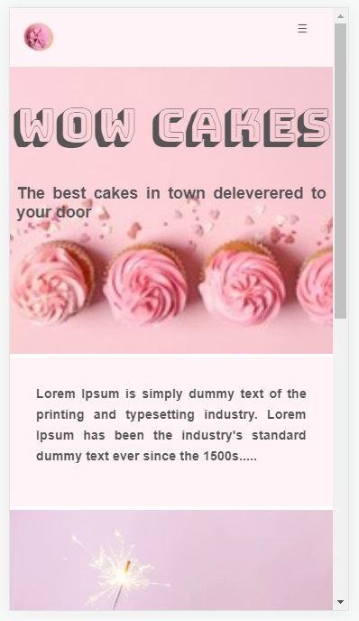

Responsive screen templates
https://codepen.io/jude1/live/a951c109e5d2eb576771f6a1e278cf3a

